Slide 1
Docker Session
Trainer : Sundararajan

Slide 2
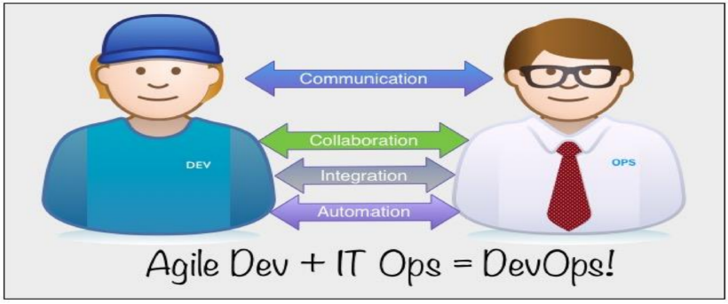
Devops overview

Slide 3
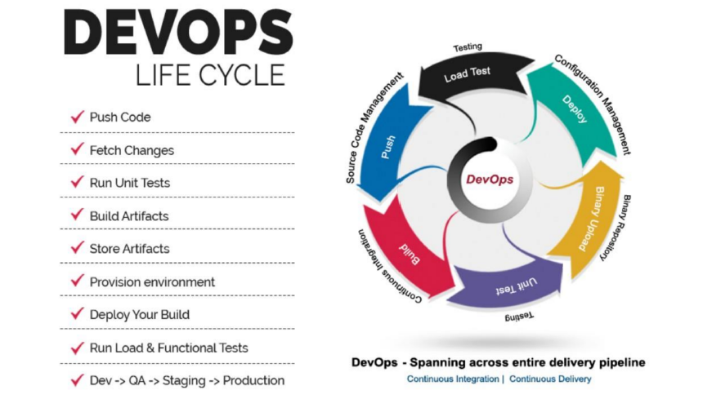

Slide 4
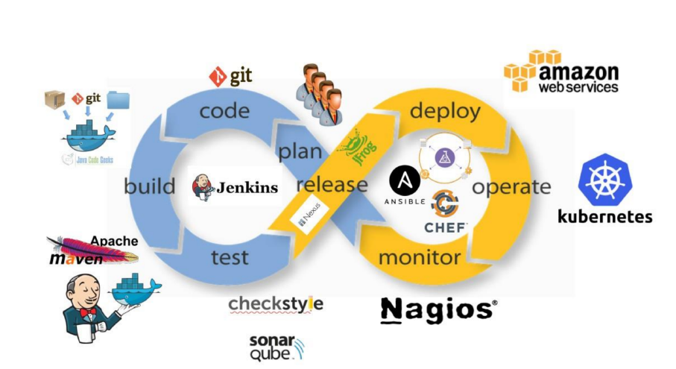
MOM
Devops Tools overview

Slide 5




















Assess Tech & Tool
Landscape
Assess Future Technology Roadmap
Map Tool Features and Identify Gaps
Identify
Opportunities for Seamless Toolchain
Define Tool Roadmap with Existing & New tools (if any)
Optimized & Integrated Enterprise, Open Source & Vendor Tools
Approach to optimize tool set
Requirements & Design
Source Code
Build/Package &
Continuous Integration
Unit Testing
Code Quality/Security & Artifact Repo
Cloud Services Platform
Non Production Environment
Cognizant DevOps Framework
Deploy to NPE Environment
InsightsTM | BuildOn | ExtendCD | OnBot
Log Tickets
Monitoring & Feedback
Update CMDB
Deploy to
Production
Release Mgmt
Approvals
Integration &
Functional Testing
ELK

Slide 6
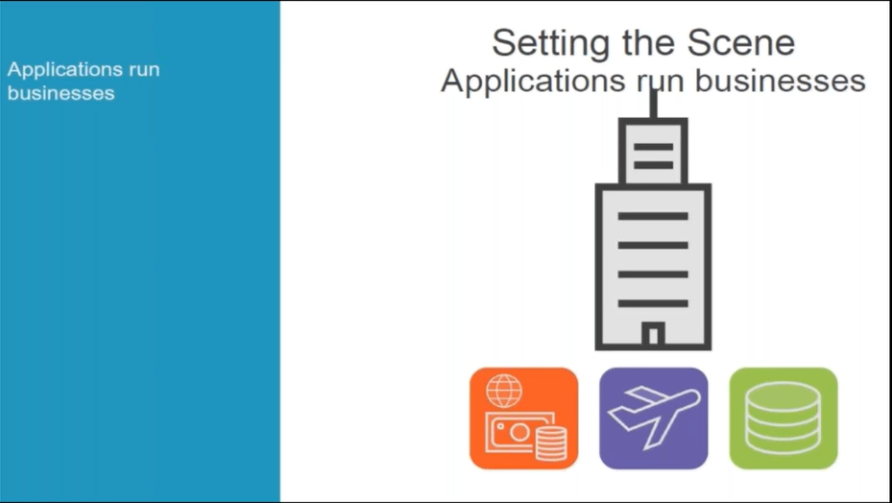
Application overview

Slide 7
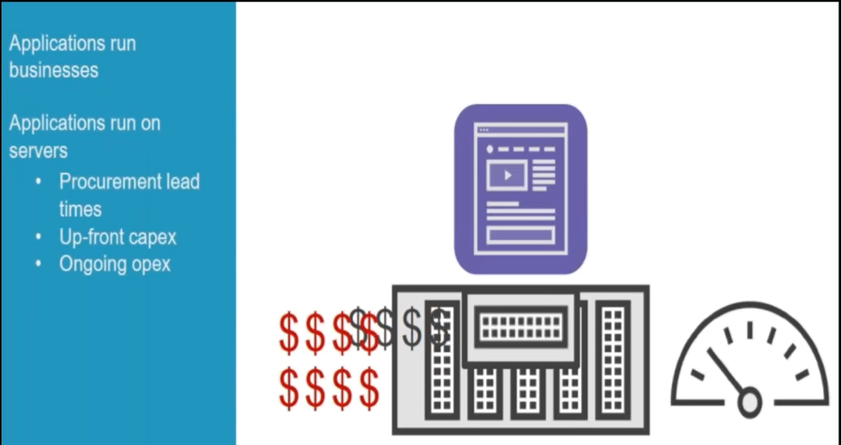
Application overview

Slide 8
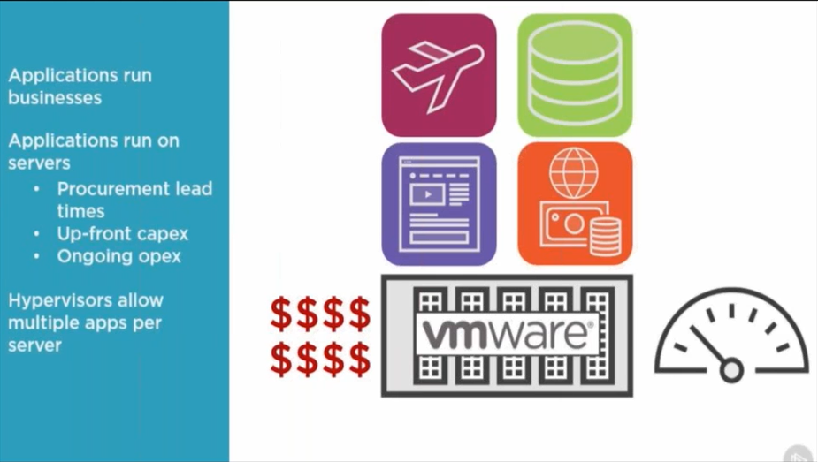
Application overview

Slide 9
Dockers vs Virtualization

Slide 10
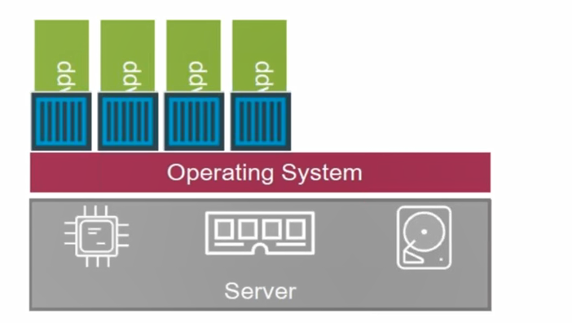
Dockers vs Virtualization

Slide 11
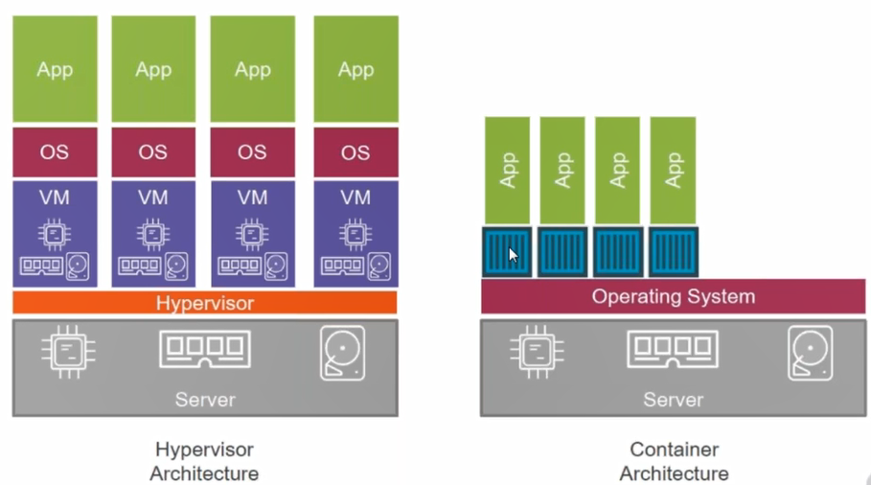
Dockers vs Virtualization
Notes:
Take an example of Amazon website and it offers big million day. Microservices (Multiple services). Each services hosted on container.ex: Registration service , seller service, shopping service.

Slide 12
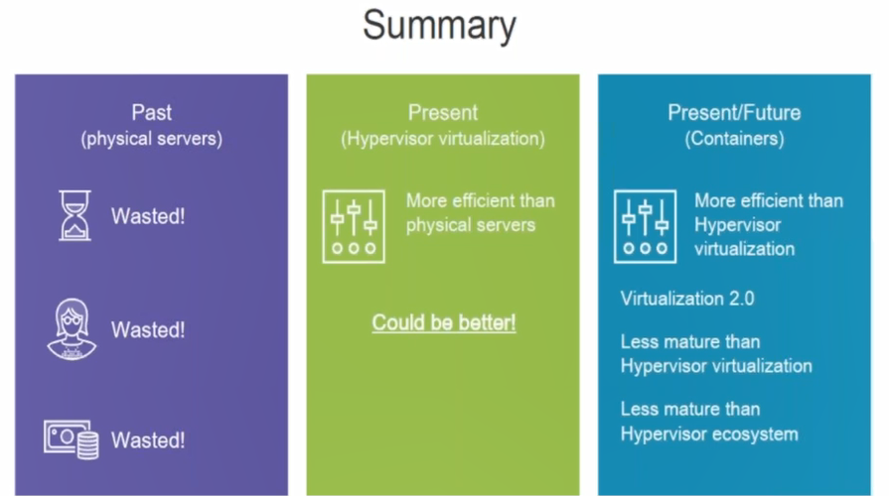
Dockers vs Virtualization

Slide 13
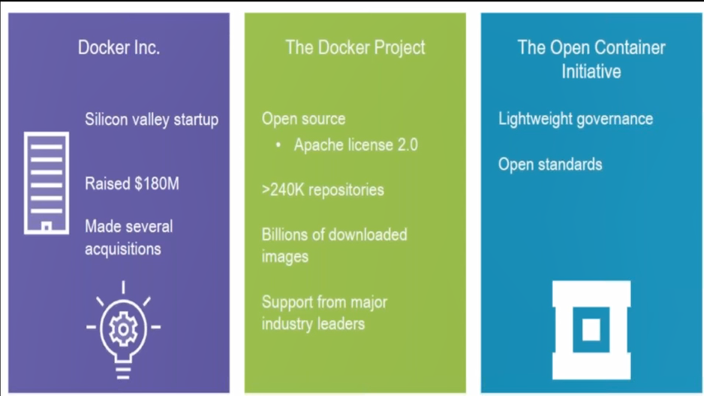
Docker and containers
Notes:
Dotcloud.(Web hosting company)

Slide 14
Docker Introduction
Docker is open source platform
Developing , Shipping ,running applications
A container is a way of packaging a software into standardized units for development,
shipment and deployment.
Significantly reduce the delay between writing code and running it in production
Docker container – Docker provides the ability to create a package and run a application in a loosely isolated environment called a container.
Docker engine will allow us to create a number of containers.
Host operating system – Docker technology we use a single operating system called host operating system. In single operating system we can create multiple containers. These containers holds the applications. For example if you are working in application 1 and this is not going to impact application 2 and it works completely isolated environment.

Slide 15
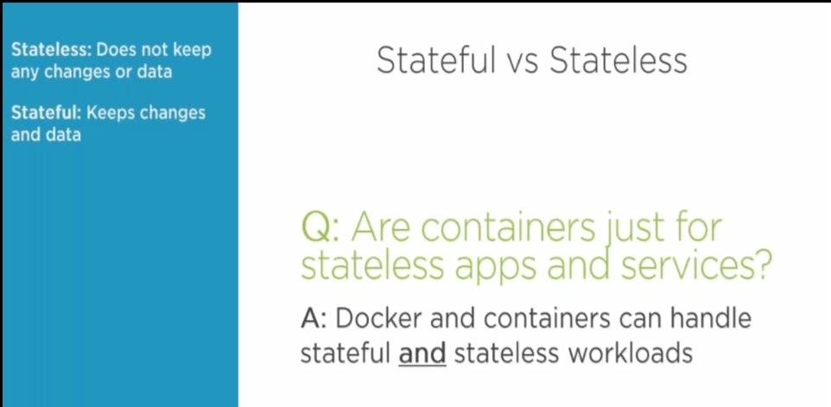
Stateless vs Stateful

Slide 16
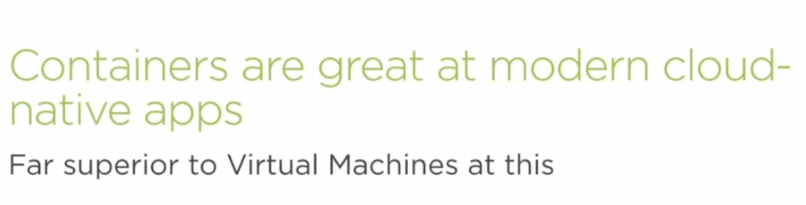
Cloud providers
Notes:
All the cloud providers are happy to incorporate the container technologies.

Slide 17
Microservices
Example of Microservices
Administration
Query
Registration
Notification
APP
Web server
Server
Notes:
Applications are divided into Microservices and each of treated as components and we are storing this details in our container.

Slide 18
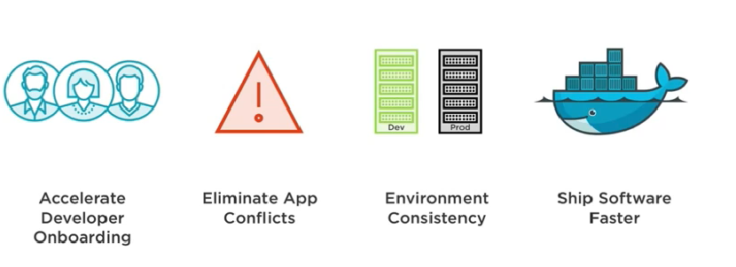
Dockers Advantages

Slide 19
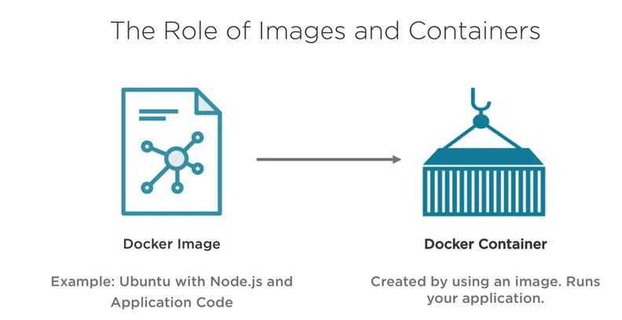
Role of Images and Container

Slide 20
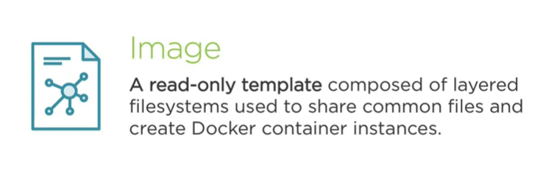
Docker Image

Slide 21
Docker components
Docker daemon
The Docker daemon (dockerd) listens for Docker API requests and manages Docker objects such as images ,containers ,network ,and volumes.
Docker Client
The Docker client (Docker) is the primary wat that many Docker users/interact with Docker, When you use commands such as Docker run , the client sends these commands to dockerd, when carries them out.
Docker registries
Docker pull or docker run commands ,the request images are pulled from your configured registry.
Images
An image is ready only template with instructions for creating a Docker container. Image is based on another image , with some additional customization.

Slide 22
Docker Containers
Developers and IT operations to work with containers
Container OS will come from the host OS.
There is sharing between Dev and IT operations
Container OS is not complete OS and it will contain only required tools and applications . The rest of the packages and other functionalities resides in Host OS.
Containers will take less time response in terms of migration activities
Runtime is a component that allows containers to run the applications that we called Docker Dameon which is running top of OS called Docker engine.

Slide 23
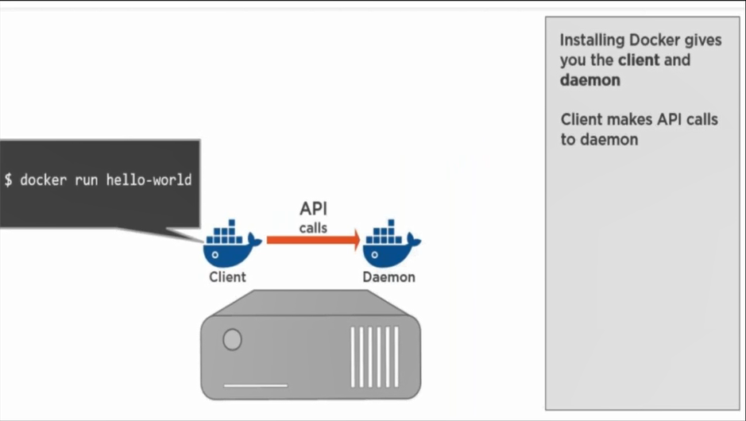
Docker working model

Slide 24
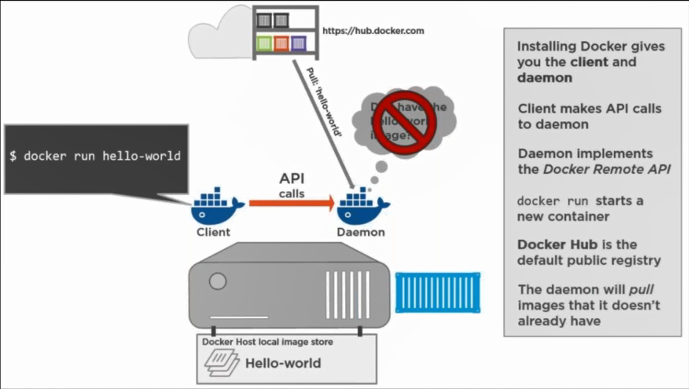
Docker working model

Slide 25
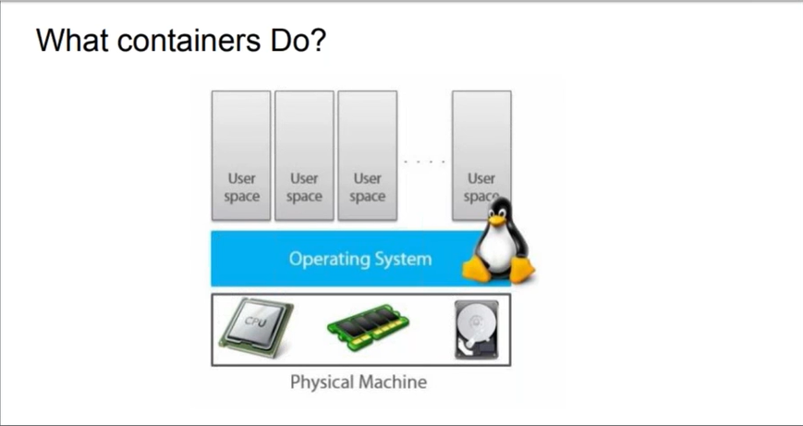
Docker – User space

Slide 26
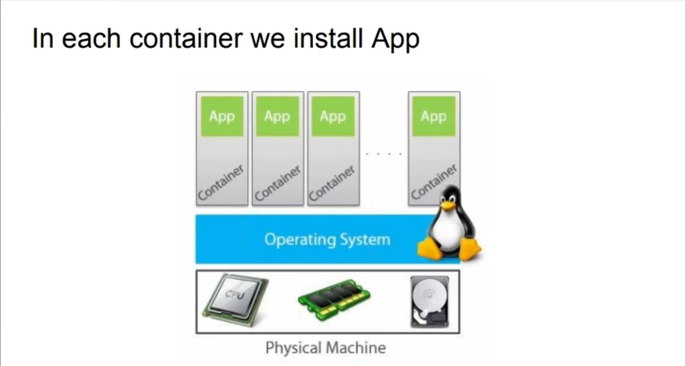
Application container

Slide 27
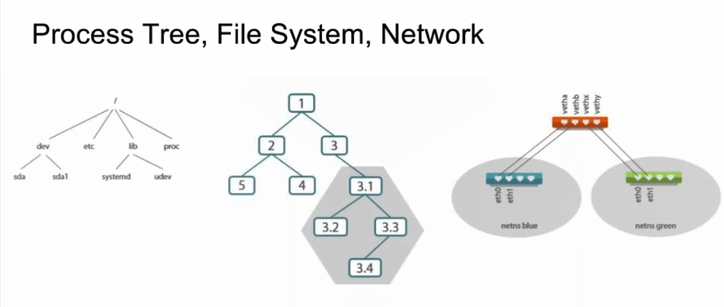
Process Tree structure

Slide 28
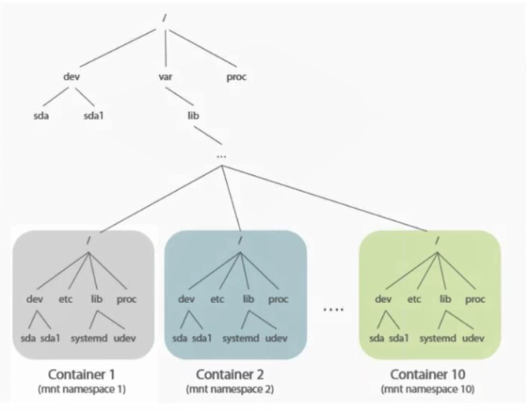
Container namespace

Slide 29
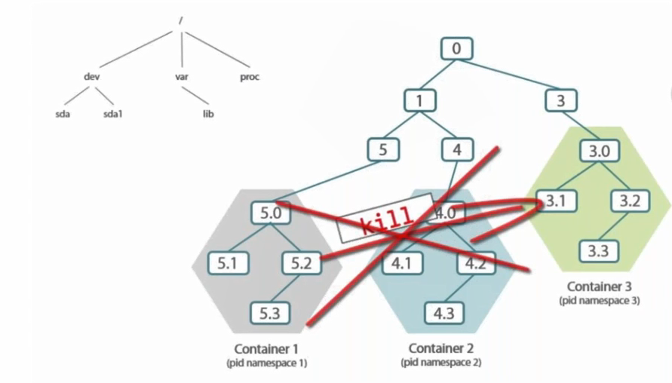
Namespace workflow vs Container

Slide 30
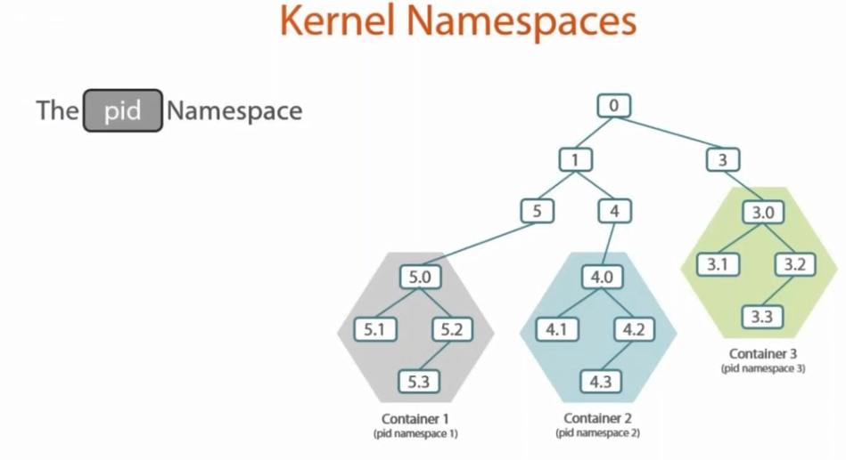
Kernel Namespaces

Slide 31
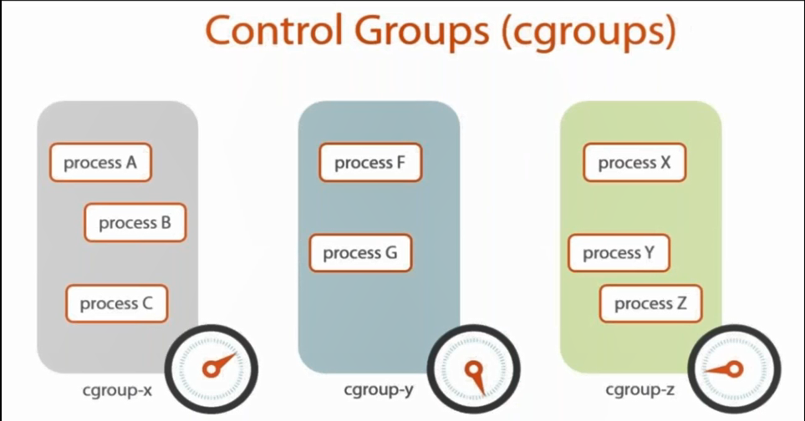
Control Groups
How much memory and virtual space needed.

Slide 32
Docker Installation
First remove older version of docker (if any):
sudo yum remove docker docker-common docker-selinux docker-engine-selinux docker-engine docker-ce
sudo yum install -y yum-utils device-mapper-persistent-data lvm2
sudo yum-config-manager --add-repo https://download.docker.com/linux/centos/docker-ce.repo
sudo yum install docker-ce
sudo systemctl enable docker.service
sudo systemctl start docker.service ## <-- Start docker ##
sudo systemctl stop docker.service ## <-- Stop docker ##
sudo systemctl restart docker.service ## <-- Restart docker ##
sudo systemctl status docker.service ## <-- Get status of docker ##
docker run debian echo “testing docker"

Slide 33
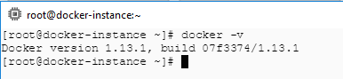
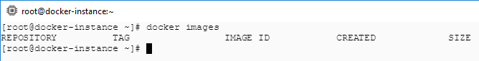
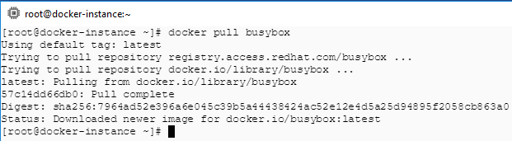
Container life cycle
1. docker –v or docker –version
2. docker images: To get the list of all the local images.
3. docker pull: To pull the docker images from docker hub if doesn’t present locally. docker pull busybox
Created
Paused
Restart
Running
Pause
Stopped
Stop
Kill
Killed

Slide 34
Docker commands
Docker Key concepts
Docker Commands
Containers: A container is a running instance of an image. We will have multiple containers running from the same image.
Images: An image is a collection of file system layers and some metadata. We can spin up the containers using these images.
Metadata: ex: port mappings , Environment variables
Layers: A layer is a collection of changes to files. The difference in version 1 and version 2 of the applications are stored in this layer.
docker pull Ubuntu
Pull the image from the docker hub if doesn’t exist in the local repo.
docker run –it ubuntu /bin/bash
The -i flag allows you to interact with the new process, and -t indicates that you want to set up a TTY to allow you to start a terminal (/bin/bash) inside the container.
docker images :
List of current images being displayed
docker inspect <<image_id>> | grep –A10
Layer details will be displayed. Whenever we do any modifications , the layers will be formed inside the image after we commit the transactions in the containers.

Slide 35
Docker commands
docker ps : List out all the running container details.
docker ps –a : List out all the containers. It will display the container status as well.
docker run -it -d alpine: docker image will be running in the background and created the container and it will exit automatically. We will be using docker exec command to run the container again. First take the container id using docker ps –a and run the exec command. <<use the docker start command to stat the container in case if the container is not running>>
docker exec –i –t <<container_id>> /bin/sh: This command execute the running container and enter into shell mode.
docker run will start the image in the background and returns the newly created container id.
Pass the container id to docker exec command and it will starts a new process inside an already running container.
The –i flag allows us to interact with the new process , -t indicates that it wants to setup a TTY to allow us to start the terminal /bin/sh.

Slide 36
Building docker applications
Application
(Build Dockerfile)
Using Dockerfile , we can build ,run, stop and start an application without worrying about the installations and dependencies. This is the key part docker will give it to us and it can easily managed across all the environments.
Git repo
Server1
Server2
Build
Build
Application1 docker image
Application1 docker image

Slide 37
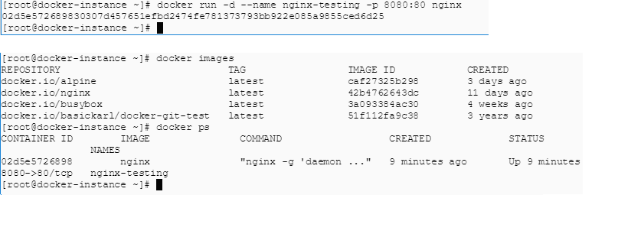
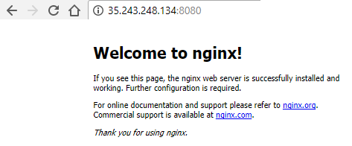
Docker container Ports
Pulling docker images
docker pull nginx
Creating container using docker run command
docker run –d –name –nginx-testing –p 8080:80 nginx
Explanation :
-d – run the container in the background.
--name – customer name for our container.
-p – port option for our container.
8080:80 – default port being forwarded to port 8080 and run the application.
External_ip:8080 : To run the application in the browser.

Slide 38
dockerfile
Sample dokerfile
Dokerfile explanation
FROM alpine:latest
LABEL maintainer="sundar <rsundar@gmail.com“
LABEL description="Dockerfile installs NGINX.“
RUN apk add --update nginx && \ rm -rf /var/cache/apk/* && \ mkdir -p /tmp/nginx/
COPY files/nginx.conf /etc/nginx/nginx.conf
COPY files/default.conf /etc/nginx/conf.d/default.conf
ADD files/html.tar.gz /usr/share/nginx/
EXPOSE 80/tcp
ENTRYPOINT ["nginx"]
CMD ["-g", "daemon off;"]
The FROM command tells Docker which base you would like to use for your image
The LABEL command can be used to add extra information to the image.
The RUN command is where we interact with our image to install software and run scripts, commands.
ADD automatically uploads, uncompresses, and puts the resulting folders and files at the path
we tell it to, which in our case is usr/share/nginx/
The EXPOSE command lets Docker know that when the image is executed, then the port and
protocol defined will be exposed at runtime.
The Dockerfile has two main purposes:
To describe the application
To tell Docker how to containerize the application (create an image with the app inside)

Slide 39
Publish docker image
Creating and publishing the images
docker build -t rsundararajandocker/mynginx:v1 .
<<Build the custom image using docker build
command. The dot represents to take the dockerfile from the current directory>>
Type docker images command and you will able to see the list of images created
Before we push the image to docker hub and we need to tag to the docker hub repo.
docker tag <<image_id>> <<dockerhub_user_id>>/<<image_name>>
Ex: docker tag 8ffbe1dd1536 rsundararajandocker/mynginx:v1
Second step we have to establish the connectivity for the docker hub from docker host using this command (docker login)
Once the login is succeeded , we have to push our image to docker hub repo.
Ex: docker push rsundararajandocker/mynginx:v1

Slide 40
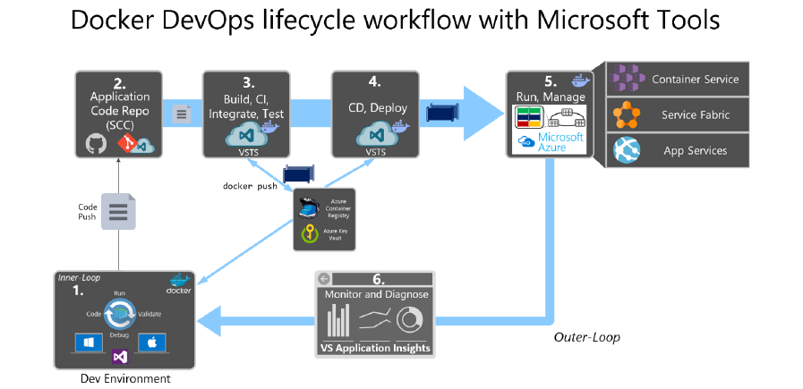
Docker lifecycle

Slide 41
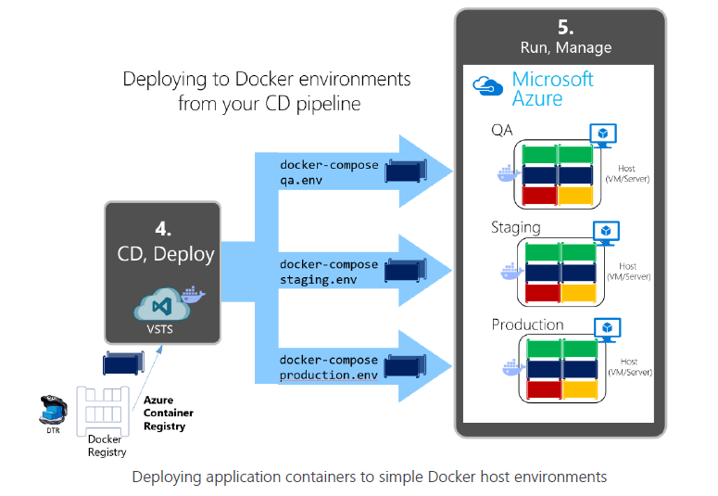
Docker lifecycle

Slide 42
Docker Commands
docker info Display system-wide information
docker version Show the Docker version information
docker run Run a command in a new container
docker ps List containers
docker rm Remove one or more containers
docker pull Pull an image or a repository from a registry
docker images List images
docker rmi Remove one or more images
docker exec Run a command in a running container
docker logs Fetch the logs of a container
docker pause Pause all processes within one or more containers
docker start Start one or more stopped containers
docker stop Stop one or more running containers
docker unpause Unpause all processes within one or more containers
docker volume Manage volumes
docker inspect detailed information on constructs controlled by Docker.

Slide 43
Case study 1
Case study 1 – Docker and Jenkins Integration
Checkout the source code from GitHub repo.
Take one web application . Ex: html pages (search it in GitHub will get one sample app)
Create a dockerfile in the same repo
In the dockerfile , install the apache server in ubuntu.
Create a image from the dockerfile
Create a container and run the web application and test it.
Jenkins
Install jenkins in the same server where docker exists
Install the require plugins in Jenkins (ex: docker)
Configure the settings in Jenkins for git,docker,Java
Create a freestyle job and provide the steps to build the docker images from dockerfile
Also create a container once the image is created
Execute the build and check the results

Slide 44
Case study 2
Case study 2 – Docker and Jenkins Integration
Checkout the source code from GitHub repo.
Build the code with Maven
Deploy the code to Tomcat with the help of docker
Dockerfile will create a container
Install the tomcat on the container
Deploy the package to tomcat server
Jenkins
Create a freestyle job in Jenkins and configure Maven, git settings
Create a docker image – Provide the command in jenkins job
Create a container – provide the command in jenkins job
Once the container is created deploy the war package into tomcat

Slide 45
Docker Commands
docker inspect --format='{{range .NetworkSettings.Networks}}{{.IPAddress}}{{end}}' $INSTANCE_ID
docker inspect --format='{{.NetworkSettings.Ports}}' d89d38e7fa28
docker inspect --format='{{range .NetworkSettings.Networks}}{{.MacAddress}}{{end}}' $INSTANCE_ID
docker inspect --format='{{.LogPath}}' $INSTANCE_ID

Slide 46
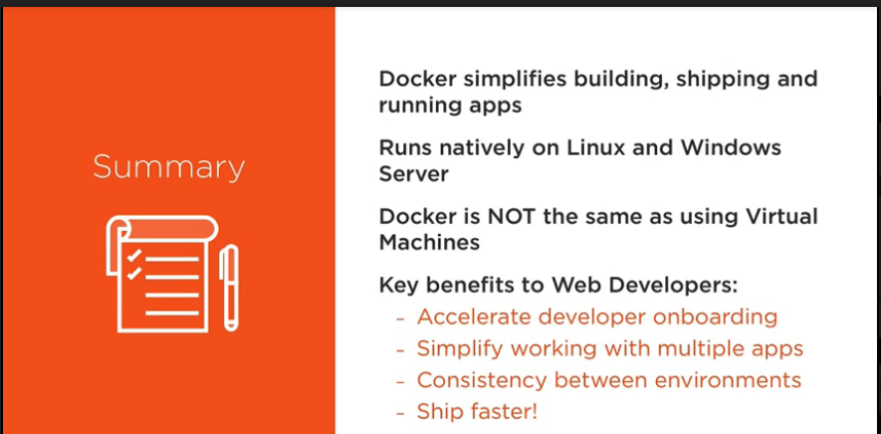
Summary

Slide 47
Thank you

